Slide 1

Library Management System

Slide 2
About me
👨‍🎓 Education
Degree: Bachelor of Technology(B.tech)
University: Pace Institute of Technology And Sciences
Year of Graduation: 2025
🎯 Why I Want to Learn Data Science
🌐 Profiles
LinkedIn: www.linkedin.com/in/venkatesh-reddy-
GitHub: https://github.com/Venky161
I want to learn data science because it blends my interest in problem-solving, statistics, and technology to extract meaningful insights from data. With its wide applications across industries, it offers the opportunity to make real-world impact. I see it as a powerful tool to solve complex problems, support smarter decisions, and advance my career.

Slide 3
Agenda
Objective of the Project
ER Diagram and schema explanation
Key analysis questions
SQL query results with screenshots or summaries
Final business insights and recommendations
Conclusion
Q&A
Experience and Challenges working on this SQL – Data Analysis Project.

Slide 4
Objective of the Project
To design and implement a relational database for a Library Management System that manages books, authors, publishers, library branches, borrowers, and book loans, ensuring efficient data handling and integrity across all operations

Slide 5
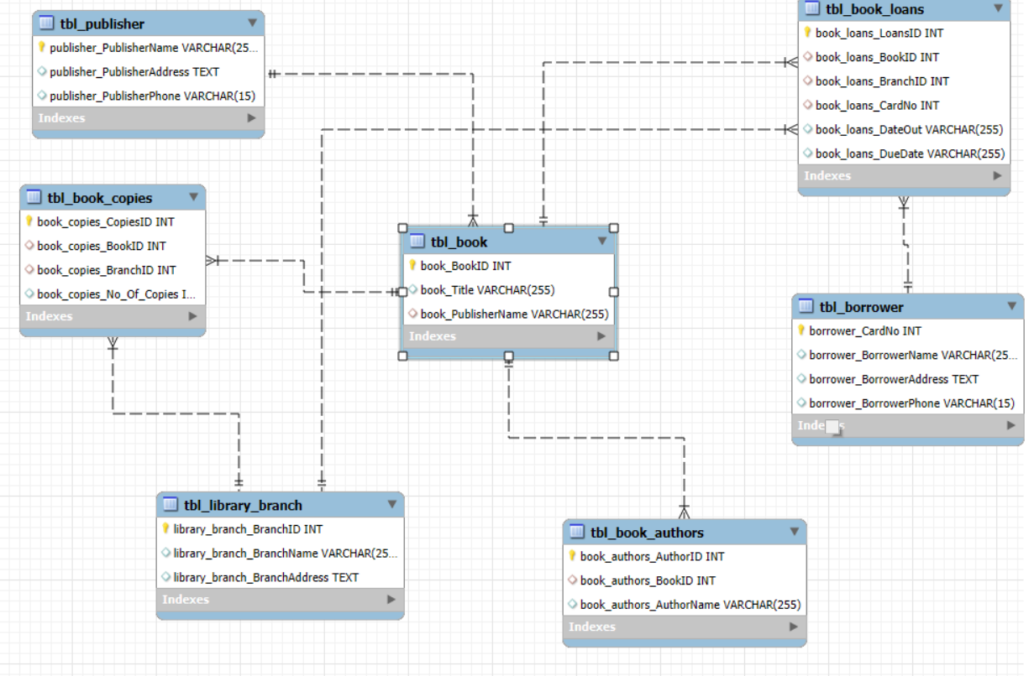
ER Diagram

Slide 6
Key Analysis Questions (use cases)
How many copies of the book titled "The Lost Tribe" are owned by the library branch whose name is "Sharpstown"?
How many copies of the book titled "The Lost Tribe" are owned by each library branch?
Retrieve the names of all borrowers who do not have any books checked out.
For each book that is loaned out from the "Sharpstown" branch and whose Due Date is 2/3/18, retrieve the book title, the borrower's name, and the borrower's address.
For each library branch, retrieve the branch name and the total number of books loaned out from that branch.
Retrieve the names, addresses, and number of books checked out for all borrowers who have more than five books checked out.
For each book authored by "Stephen King", retrieve the title and the number of copies owned by the library branch whose name is "Central".

Slide 7
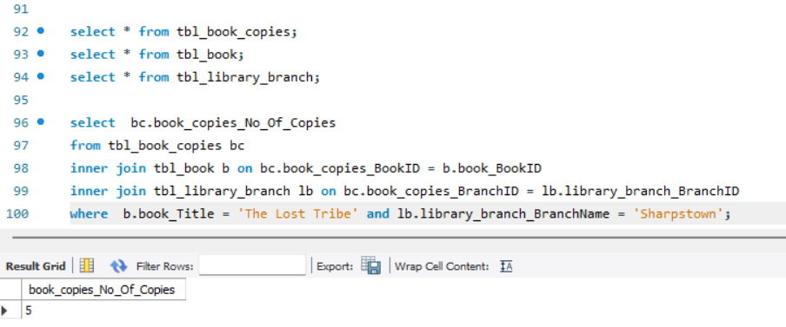
SQL Query Results With Screenshots Or Summaries
1.How many copies of the book titled "The Lost Tribe" are owned by the library branch whose name is "Sharpstown"?

Slide 8
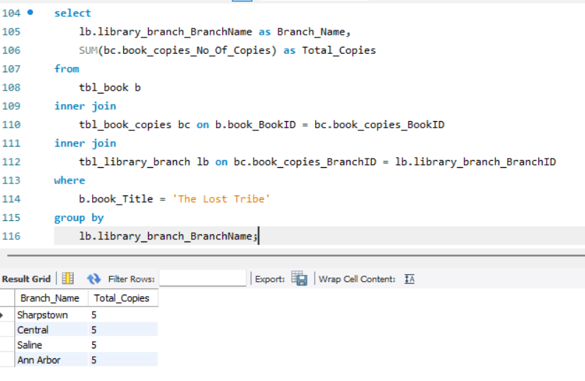
2.How many copies of the book titled "The Lost Tribe" are owned by each library branch?

Slide 9
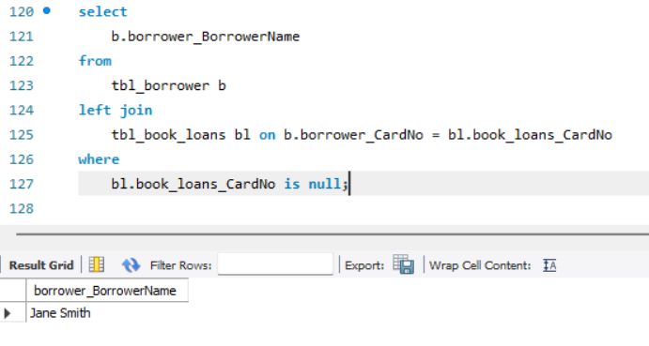
3.How many copies of the book titled "The Lost Tribe" are owned by each library branch?

Slide 10
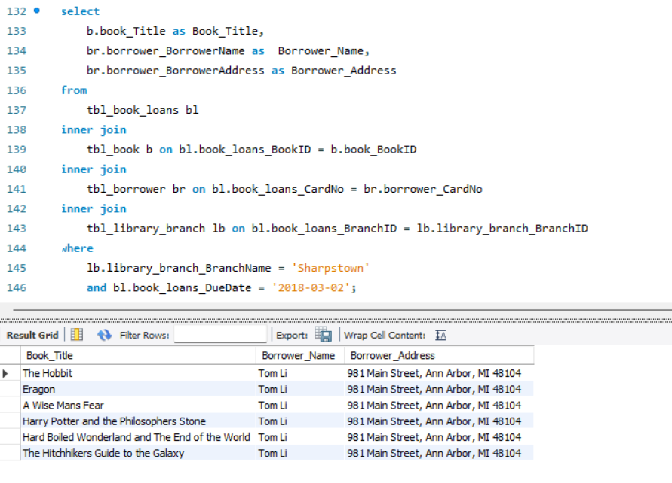
4.For each book that is loaned out from the "Sharpstown" branch and whose DueDate is 2/3/18, retrieve the book title, the borrower's name, and the borrower's address.

Slide 11
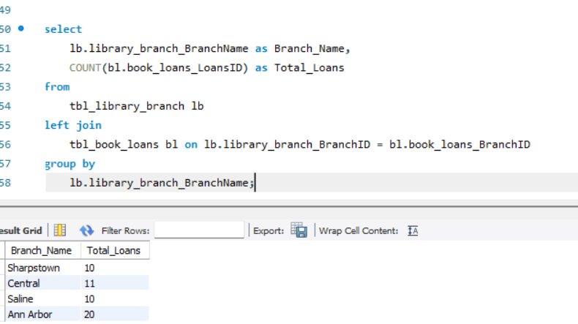
5.For each library branch, retrieve the branch name and the total number of books loaned out from that branch.

Slide 12
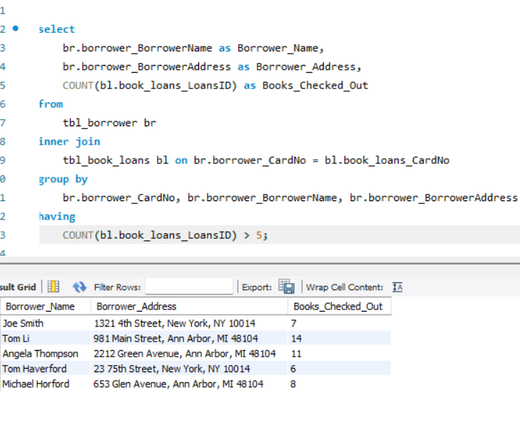
6.Retrieve the names, addresses, and number of books checked out for all borrowers who have more than five books checked out.

Slide 13
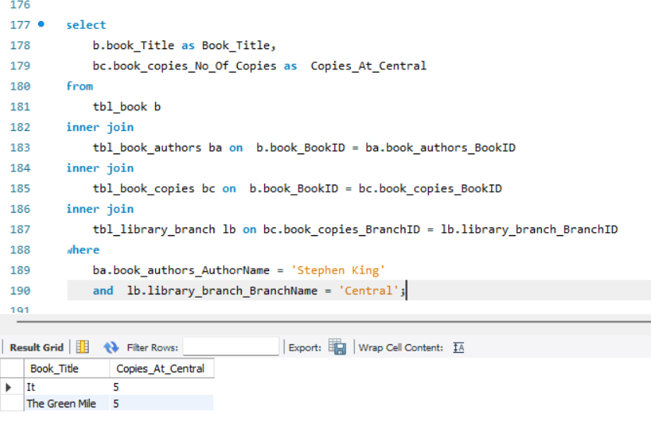
7.For each book authored by "Stephen King", retrieve the title and the number of copies owned by the library branch whose name is "Central".

Slide 14
Final Business Insights And Recommendations
Operational Efficiency – Automate book transfers and integrate SQL-based tracking for streamlined management.
Optimized Inventory Allocation – Ensure books are distributed efficiently across branches based on demand patterns.
Data-Driven Decision Making – Use historical loan data to guide acquisitions and stock adjustments.
Enhanced Borrowing Experience – Implement real-time tracking and reservation systems for better accessibility.

Slide 15
Conclusion
This Library Management System project showcases how a well-designed relational database can efficiently manage core library functions—books, authors, publishers, branches, and borrowers. By using a normalized schema with clear relationships, the system ensures accurate data handling and supports meaningful insights through SQL queries.
Key tasks included:
Tracking book copies across branches
Identifying inactive borrowers
Generating overdue book reports
Viewing author-specific inventories
Overall, the project highlights how effective database design and querying power real-world library operations and data-driven decisions.

Slide 16
Q&A
How does the database ensure data consistency and avoid duplication?
By using primary and foreign keys, the database maintains valid relationships between tables, ensuring data is consistent and duplication is prevented.
What insights can be gained from the library database? It reveals trends like popular books by branch, inactive borrowers, and frequently loaned authors—helping improve inventory and engagement.

Slide 17
Challenges Working on SQL
Understanding table relationships and applying correct joins.
Managing foreign key relationships across multiple tables requires precision to avoid data inconsistencies.
Importing data may cause errors due to missing values or mismatched column names.
Writing efficient multi-table SQL queries, especially for detailed reports, can be difficult.

Slide 18

THANK YOU

